Slide 1
Readout and Lock-In
Jonathan Hoh
3/4/2021

Slide 2
The Road to Digital Lock-in
Understanding the System
Design Software Simulation
Create DSP simulation
Generate Bitstream
Upload and Test

Slide 3





Part 1: Software Sim

Slide 4
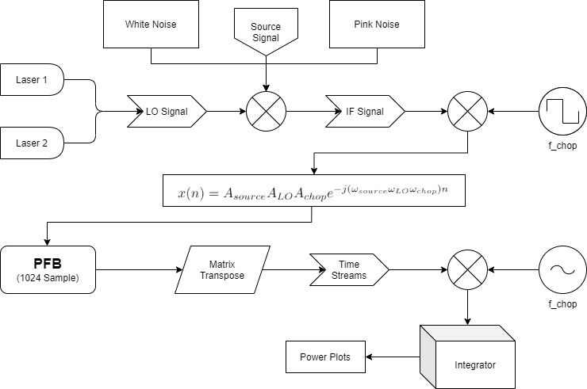
Software Simulation Diagram

Slide 5
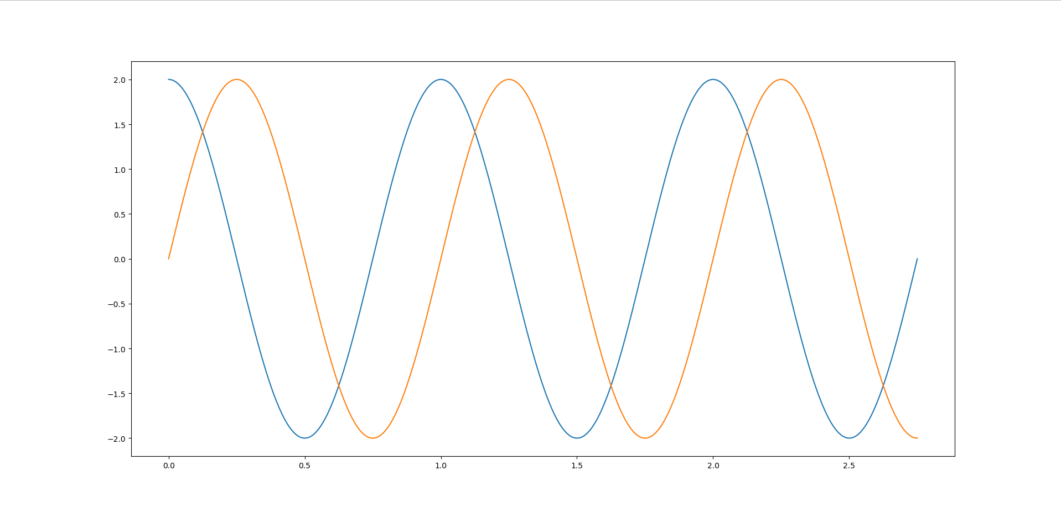
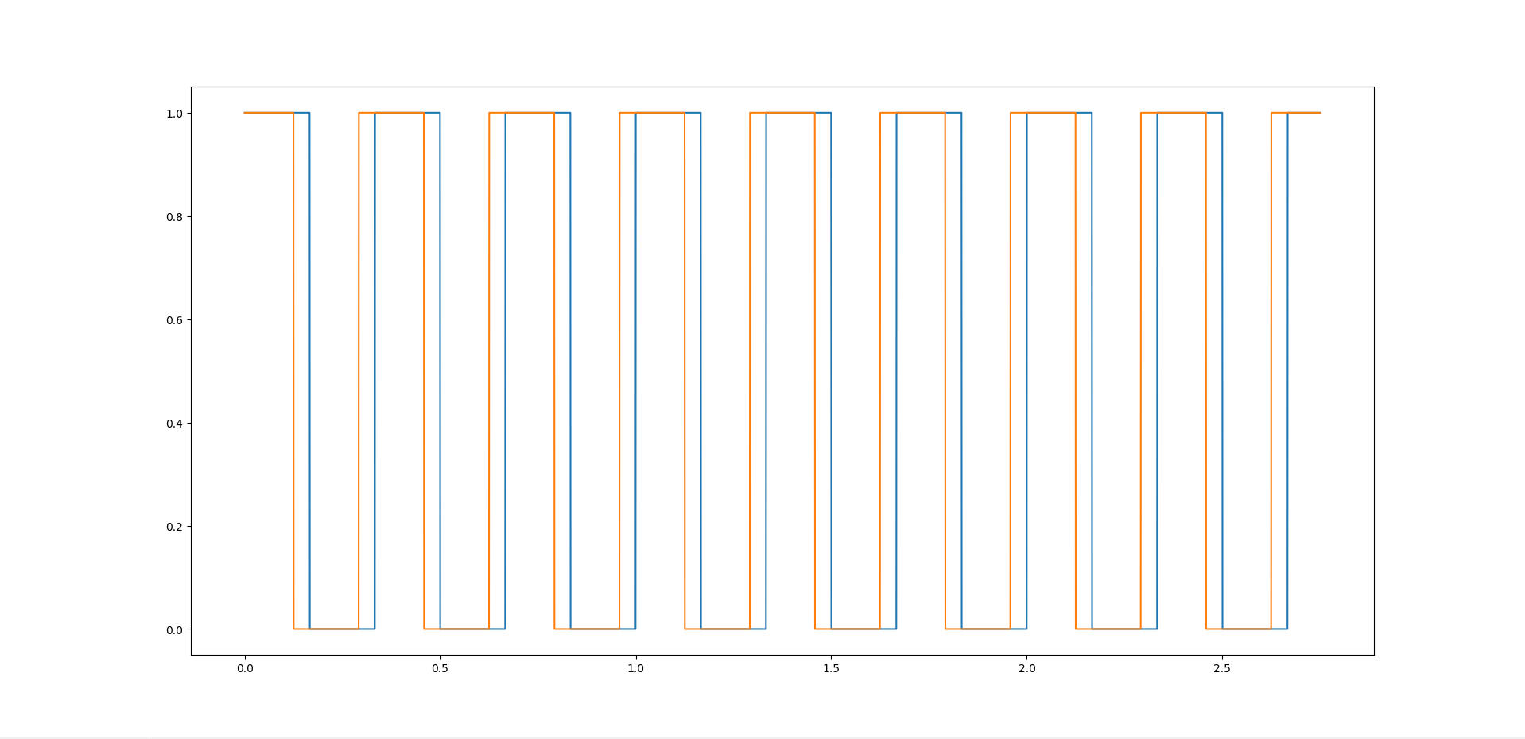
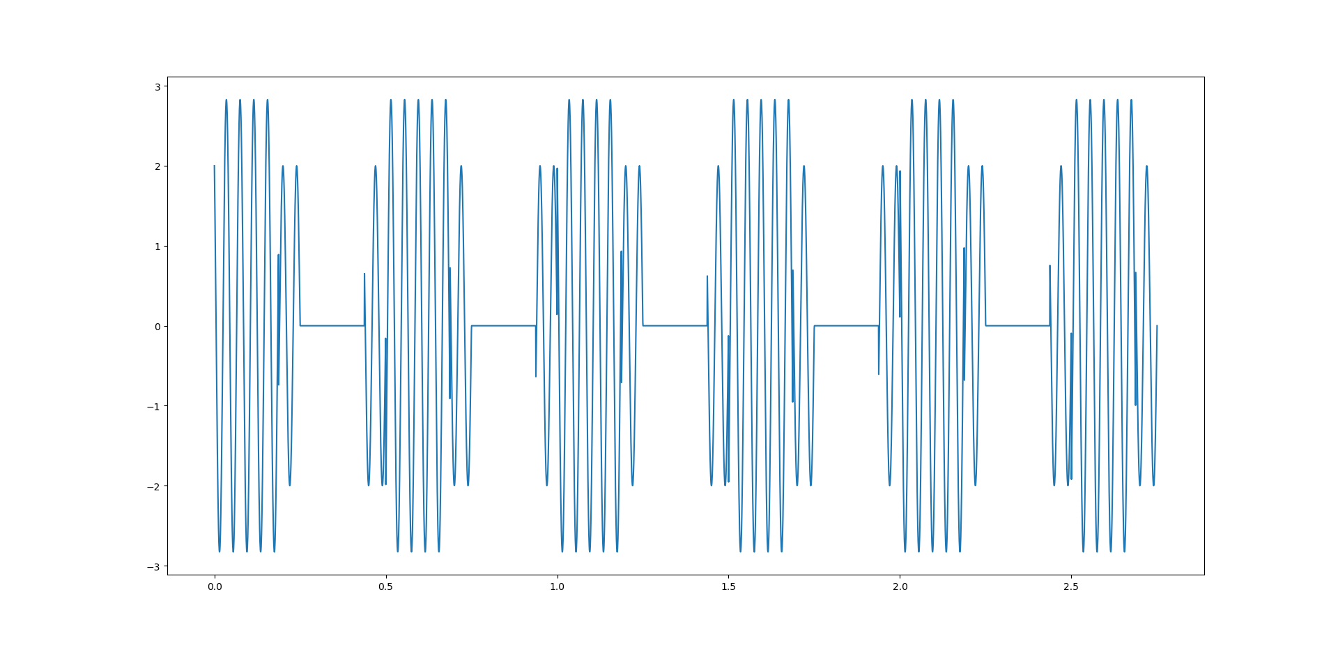
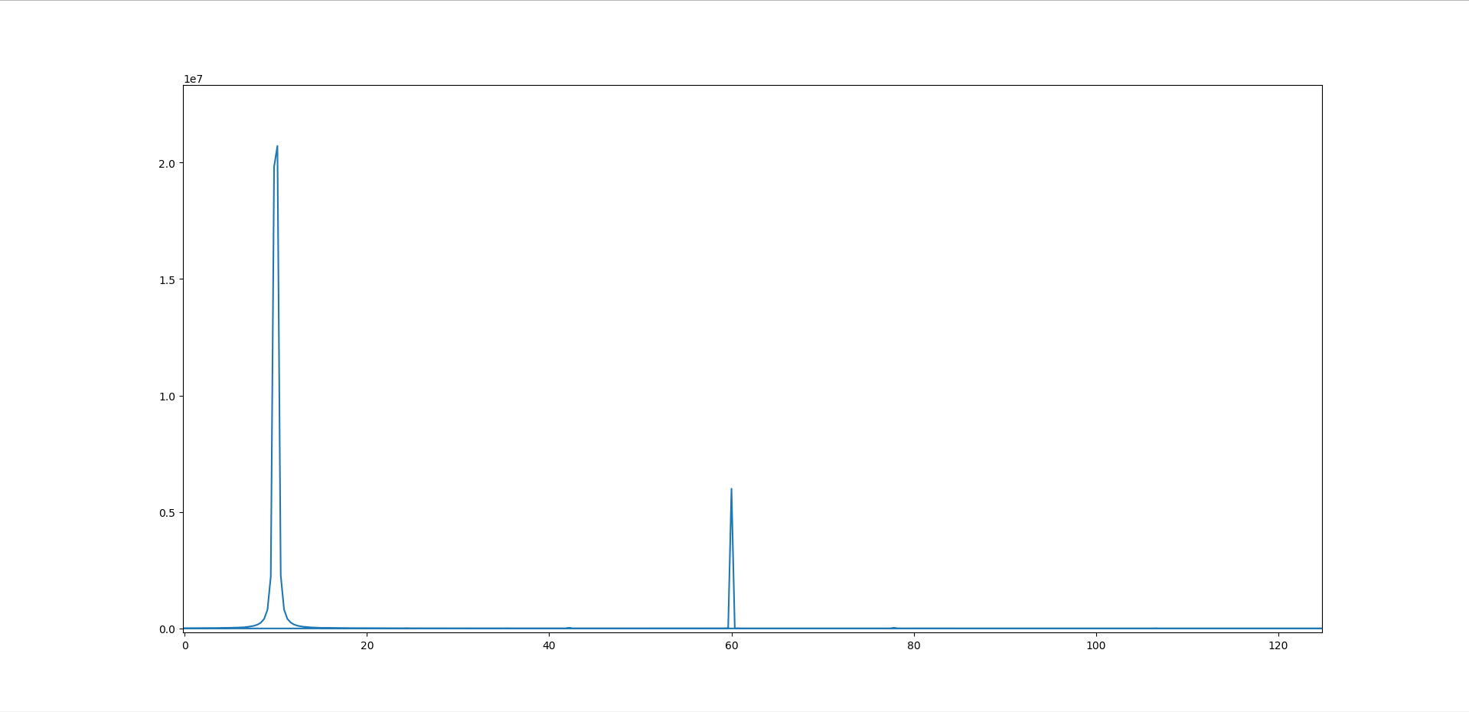
Software Simulation Prototype
Noiseless Simulation

Slide 6
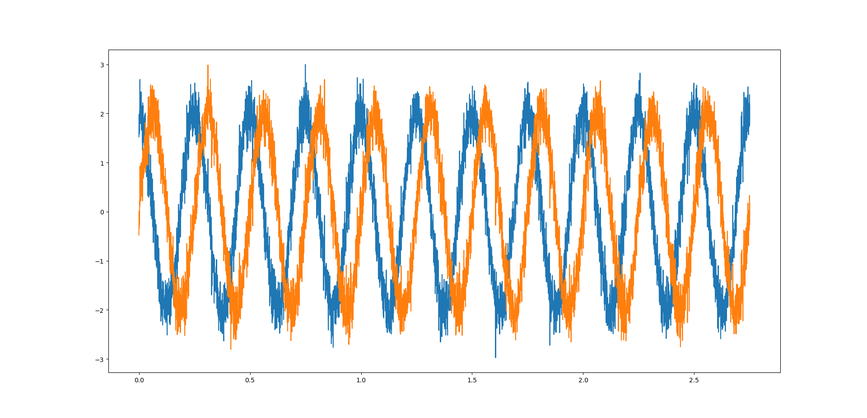
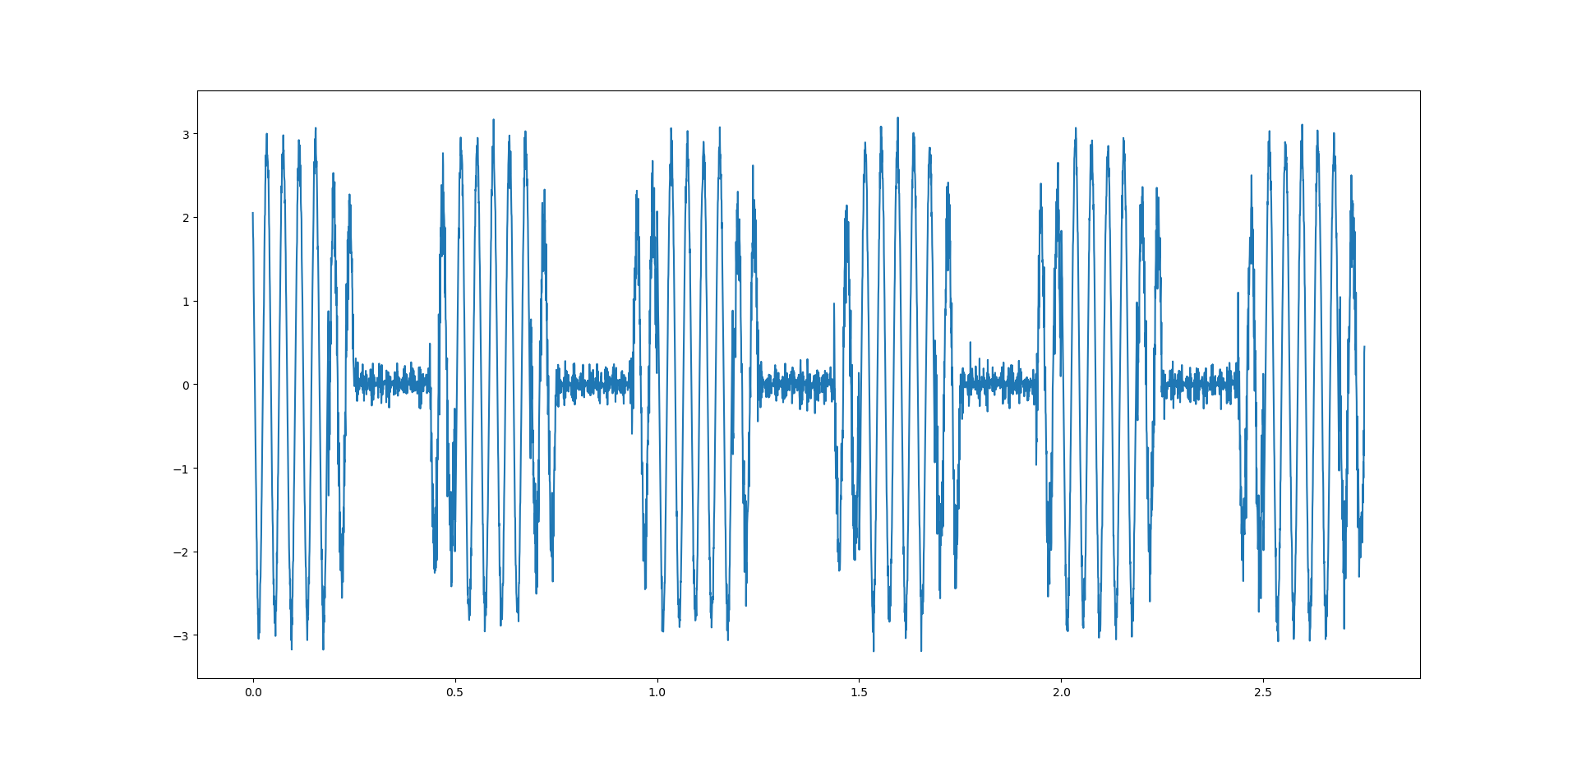
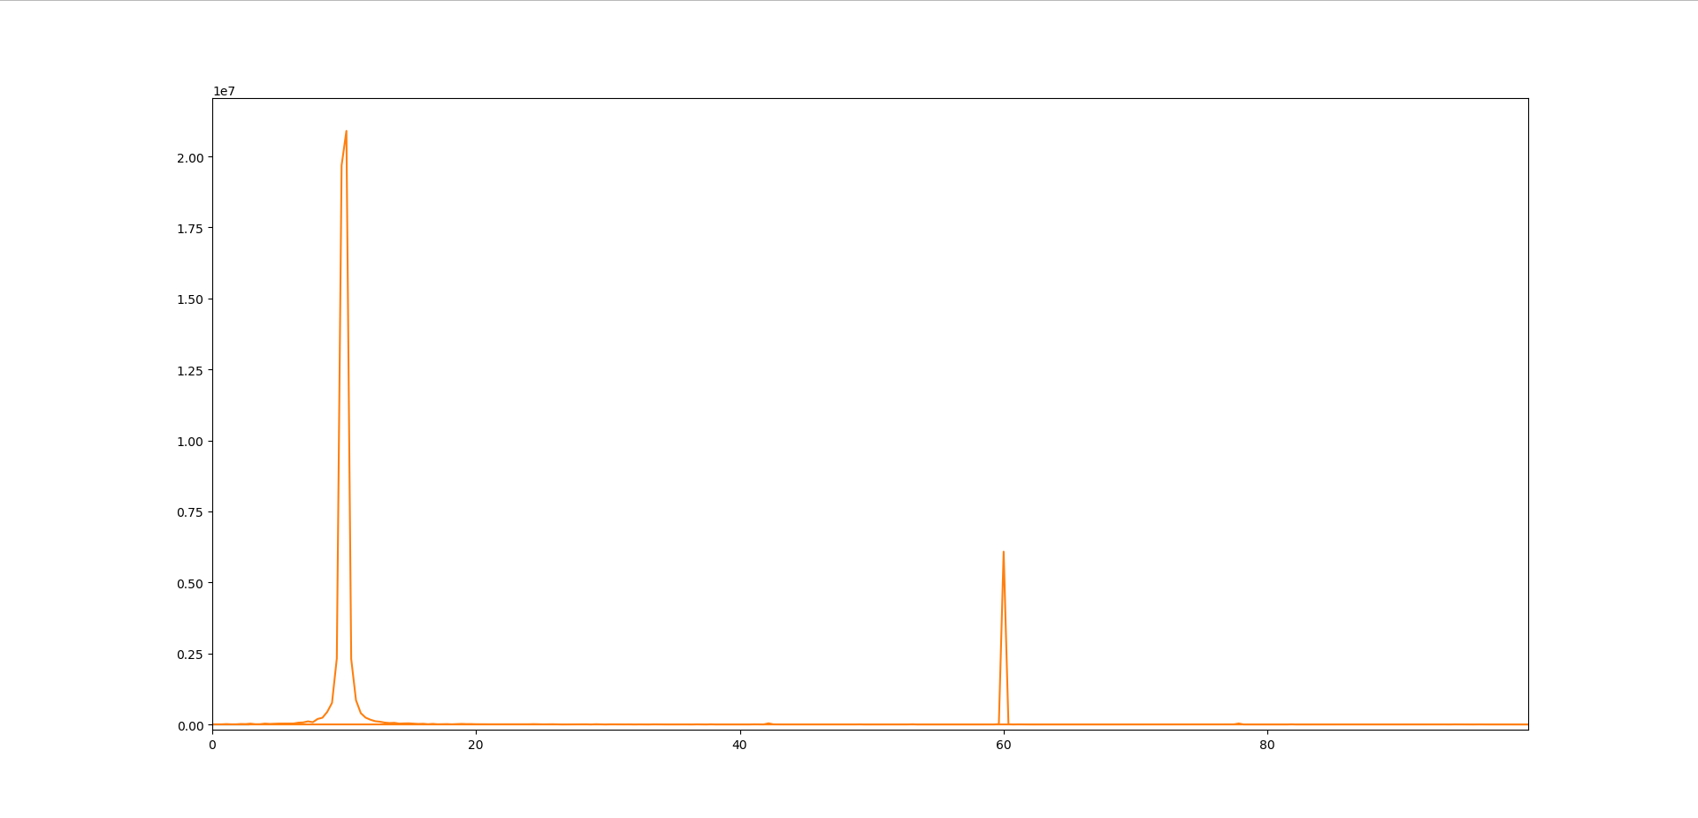
Software Simulation Prototype
Noisy Simulation

Slide 7
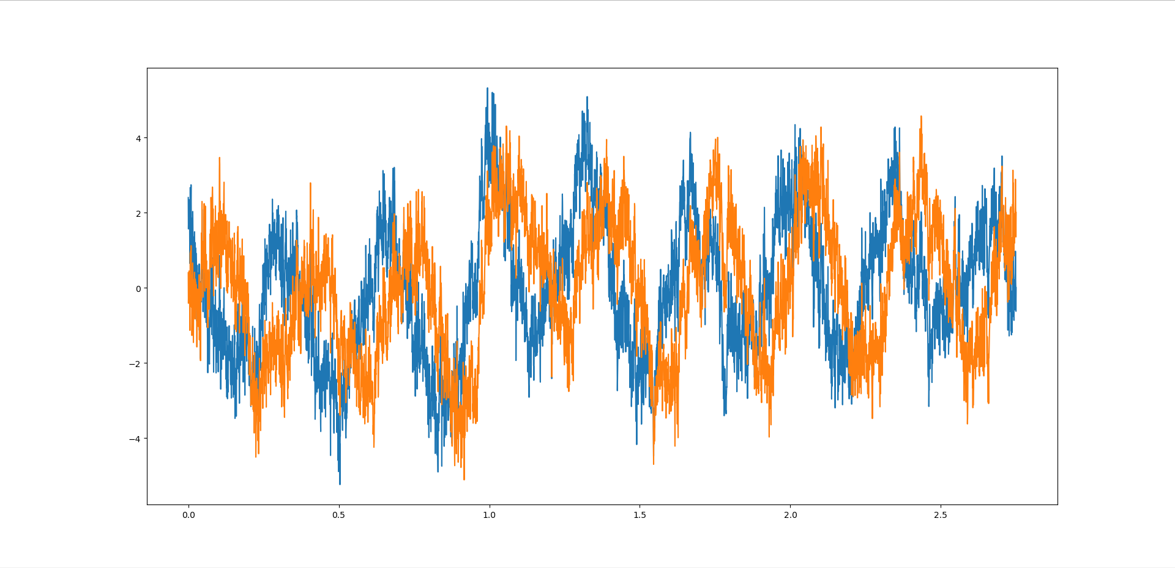
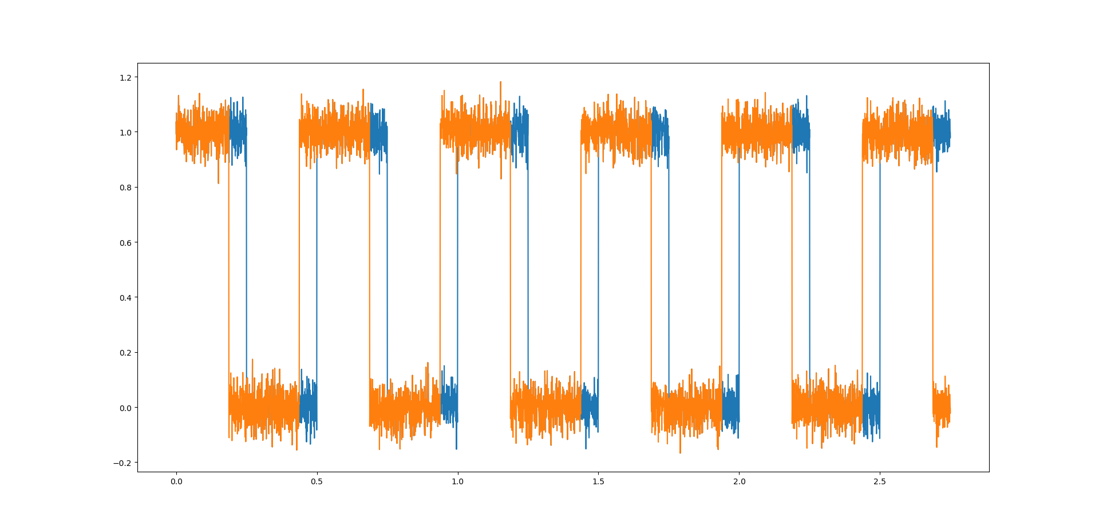
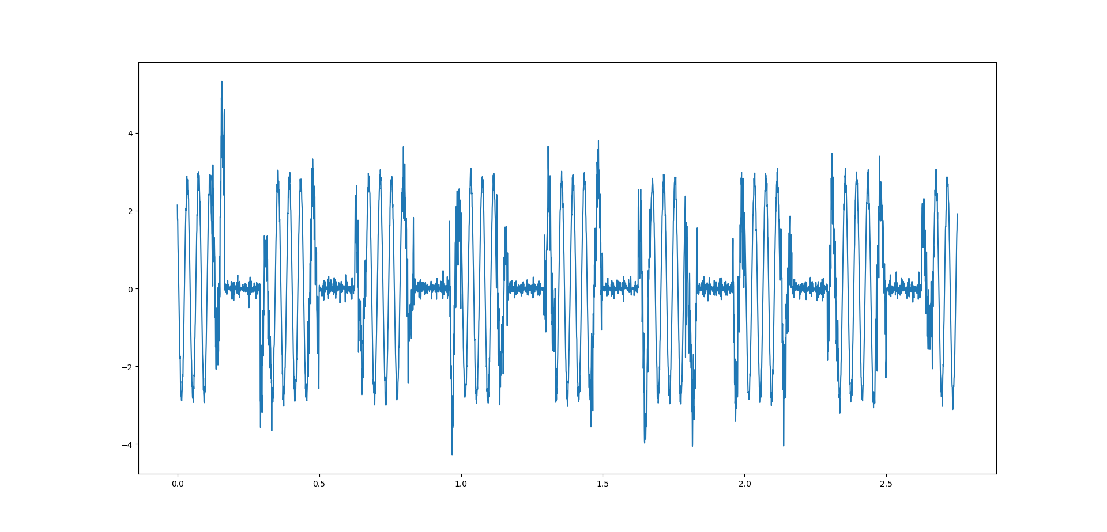
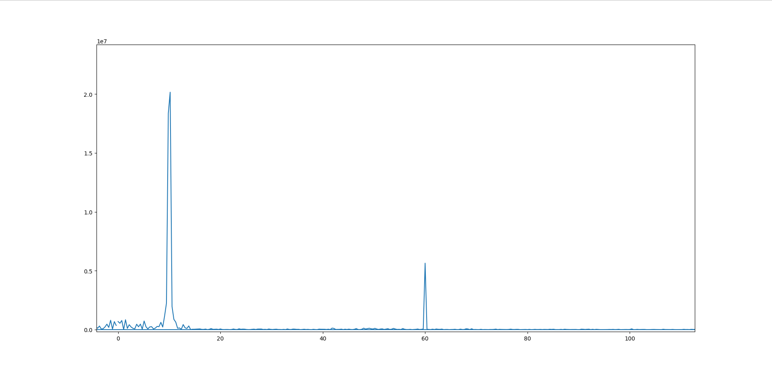
Software Simulation Prototype
Throw in some significant pink noise for good measure (I may have gone overboard)

Slide 8
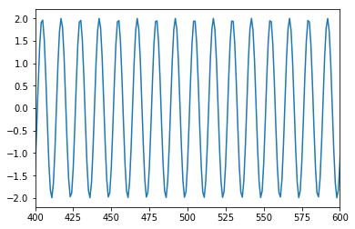
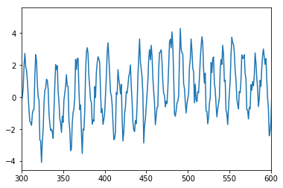
Full Scale Simulation
ADC clock = 2.5 GHz
FPGA clock = 250 MHz
LO frequency = 0.55 THz
Source frequency = 0.5498 THz
IF frequency = 200 MHz
Chop frequency = 100 KHz
FFT length = 1024
Run time = 0.3 seconds

Slide 9
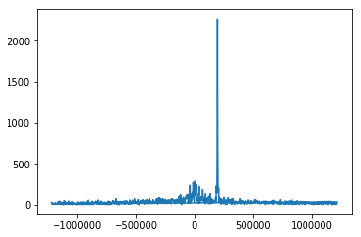
Full Scale Simulation
Mixed waveform and FFT
Centered at IF frequency

Slide 10
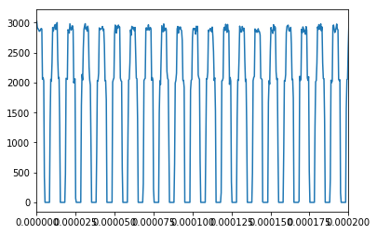
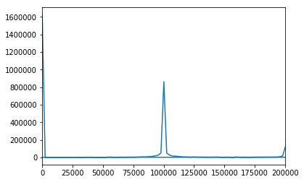
Full Scale Simulation
Time stream extraction (and frequency information)
Centered at chop frequency

Slide 11
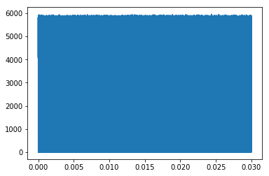
Full Scale Simulation
Mixing to DC and power level integration

Slide 12
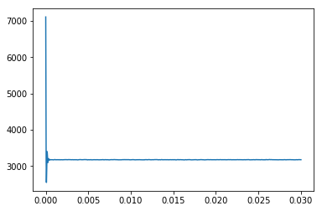
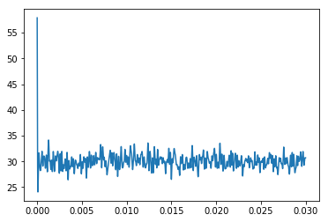
Full Scale Simulation
Phase-tweaked and integrated power levels
On-peak bin
Off-peak bin

Slide 13
Part 2: Firmware Development

Slide 14
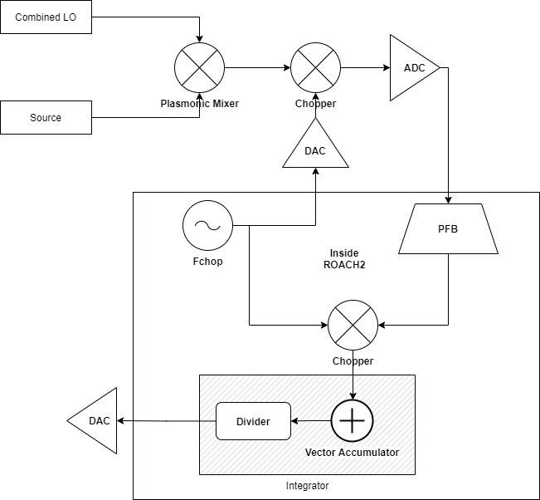
Firmware Block Designs
Simple Overview

Slide 15
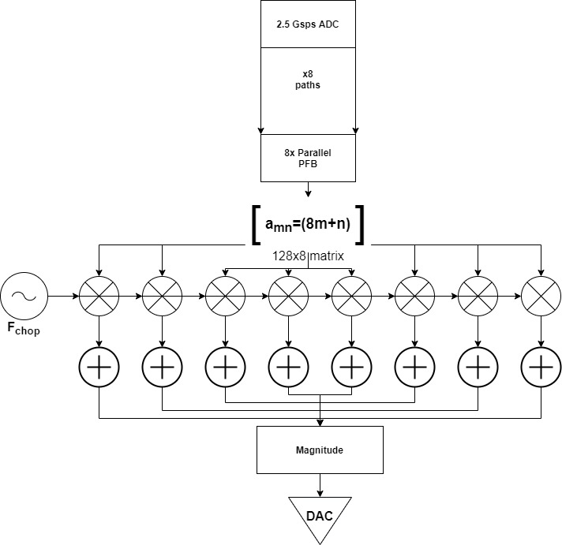
Firmware Block Designs
Parallel Pathing
Current design takes magnitude before accumulation stage
Switch

Slide 16
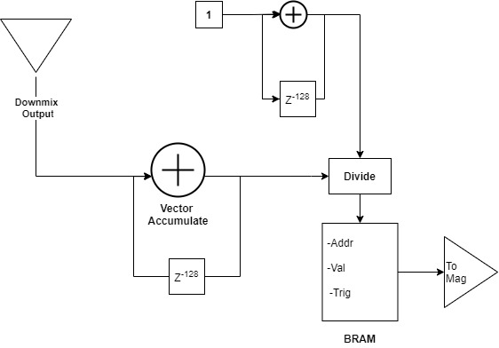
Firmware Block Designs
Accumulator/Integrator

Slide 17
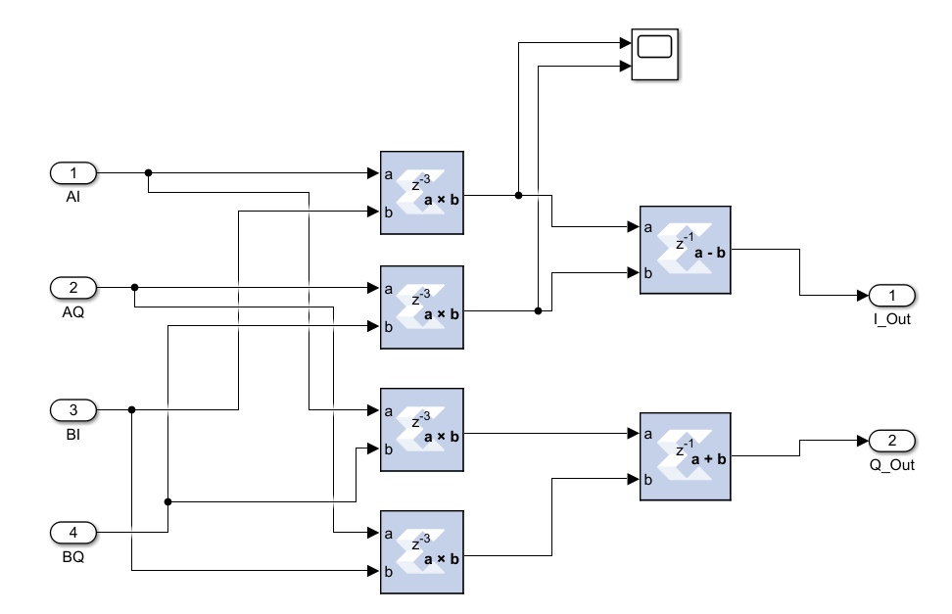
DSP Blocks
Complex Multiplier

Slide 18
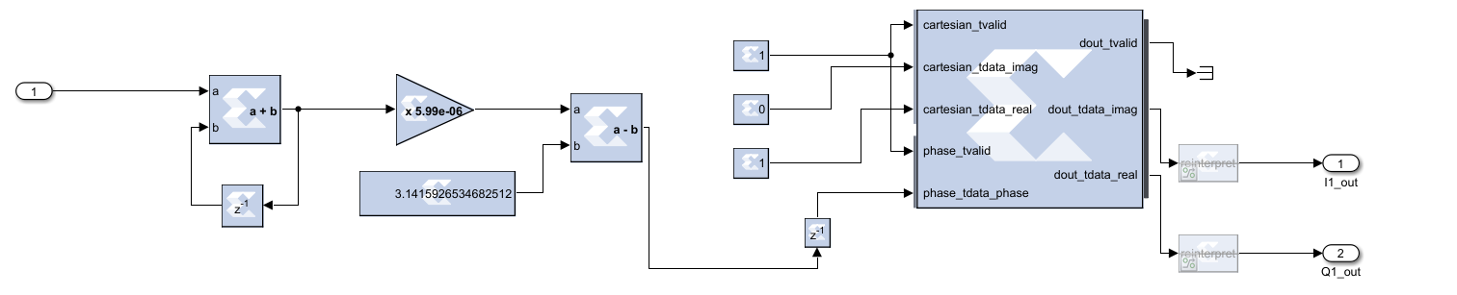
DSP Blocks
Quadrature Wave Generator

Slide 19
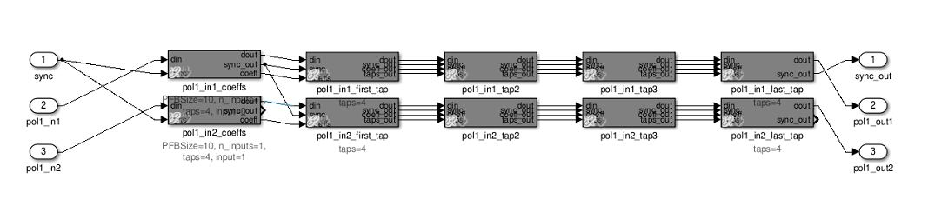
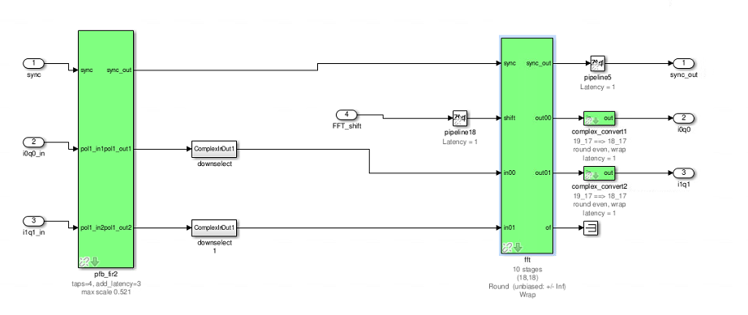
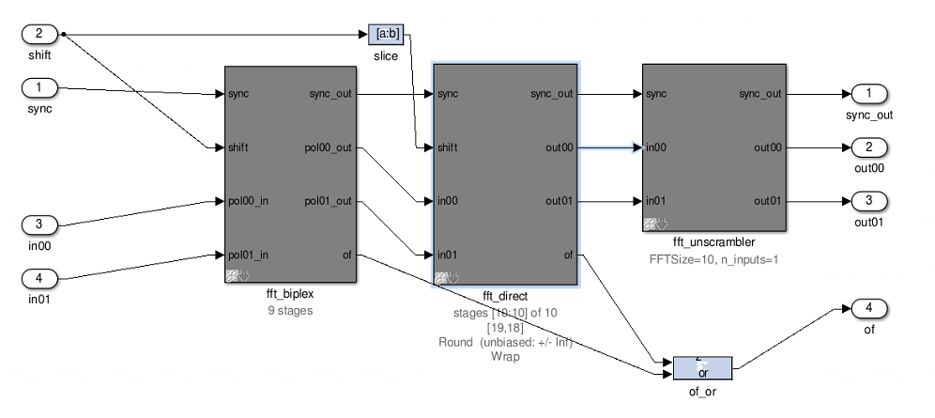
DSP Blocks
Polyphase Filter Bank
(Design copied from BLAST-TNG firmware)

Slide 20
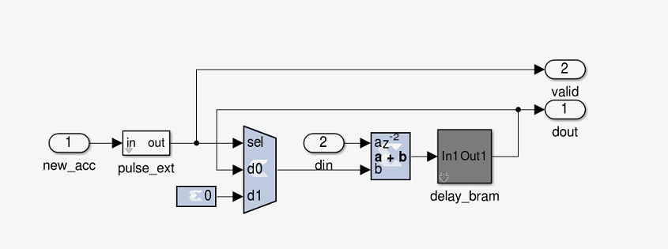
DSP Blocks
Vector Accumulator

Slide 21
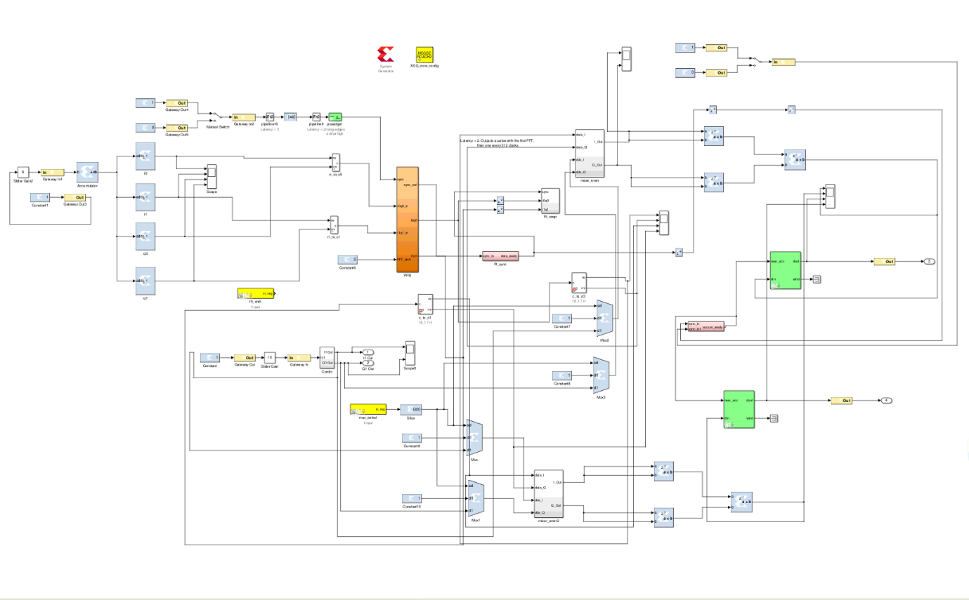
Firmware Simulation

Slide 22
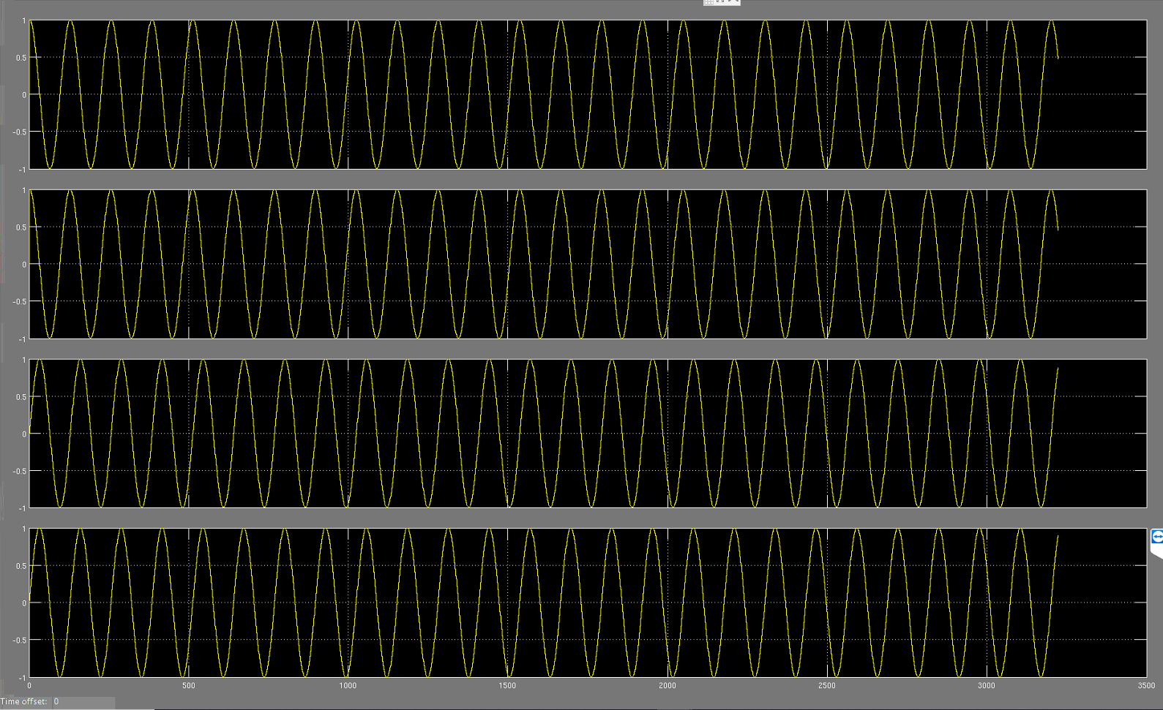
Simulation Results
Simulated Quadrature Inputs
2x parallel due to MUSIC ADC
Will be 8x in full-scale
Controllable during sims

Slide 23
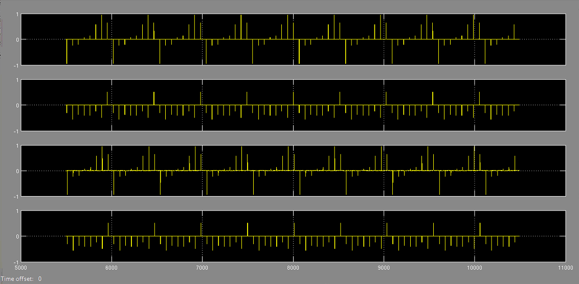
PFB/IQ Mixer test
PFB outputs I and Q
Mixer output after identity mix

Slide 24
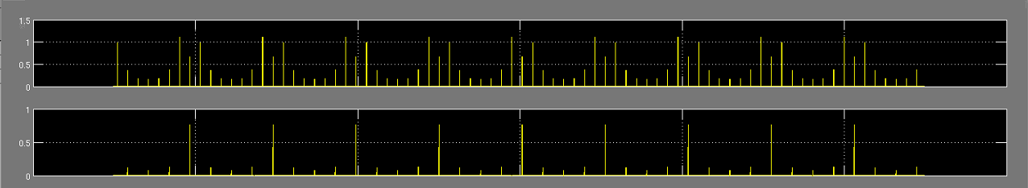
Magnitude Test
Positive and periodic, all we can ask for

Slide 25
Next Step: Compiled on FPGA
Fully testing/simulating conditions of experiment are impossible
Tests completed prove validity of all parts individually
Physical testing requires new firmware version that can compile
Once ROACH2 is available, bitstream will be uploaded
After lab test, expand to 8x parallel and test
Ready for telescope!

Slide 26
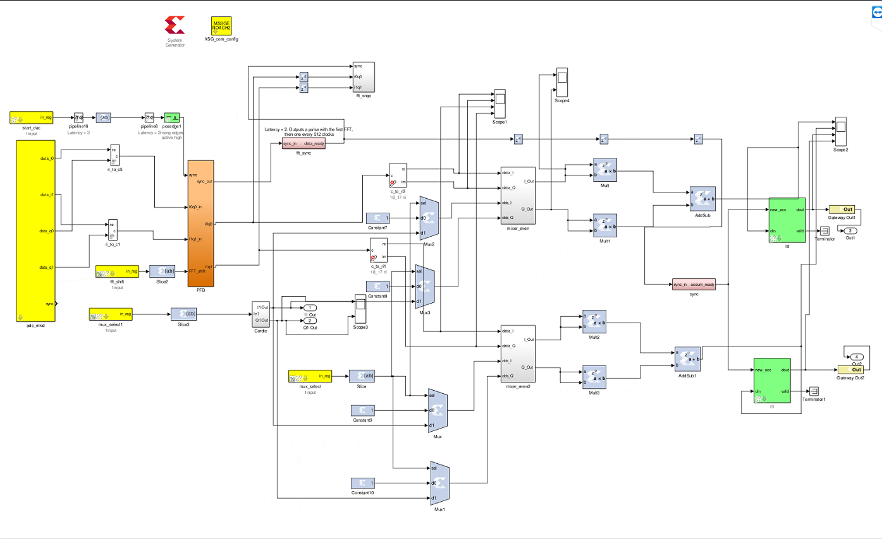
Compileable Firmware V1
Simulation components removed
Replaced with GPIO pins
Mux switches with external control in order to continue identity mixing
MUSIC ADC block with 2x parallel

Slide 27
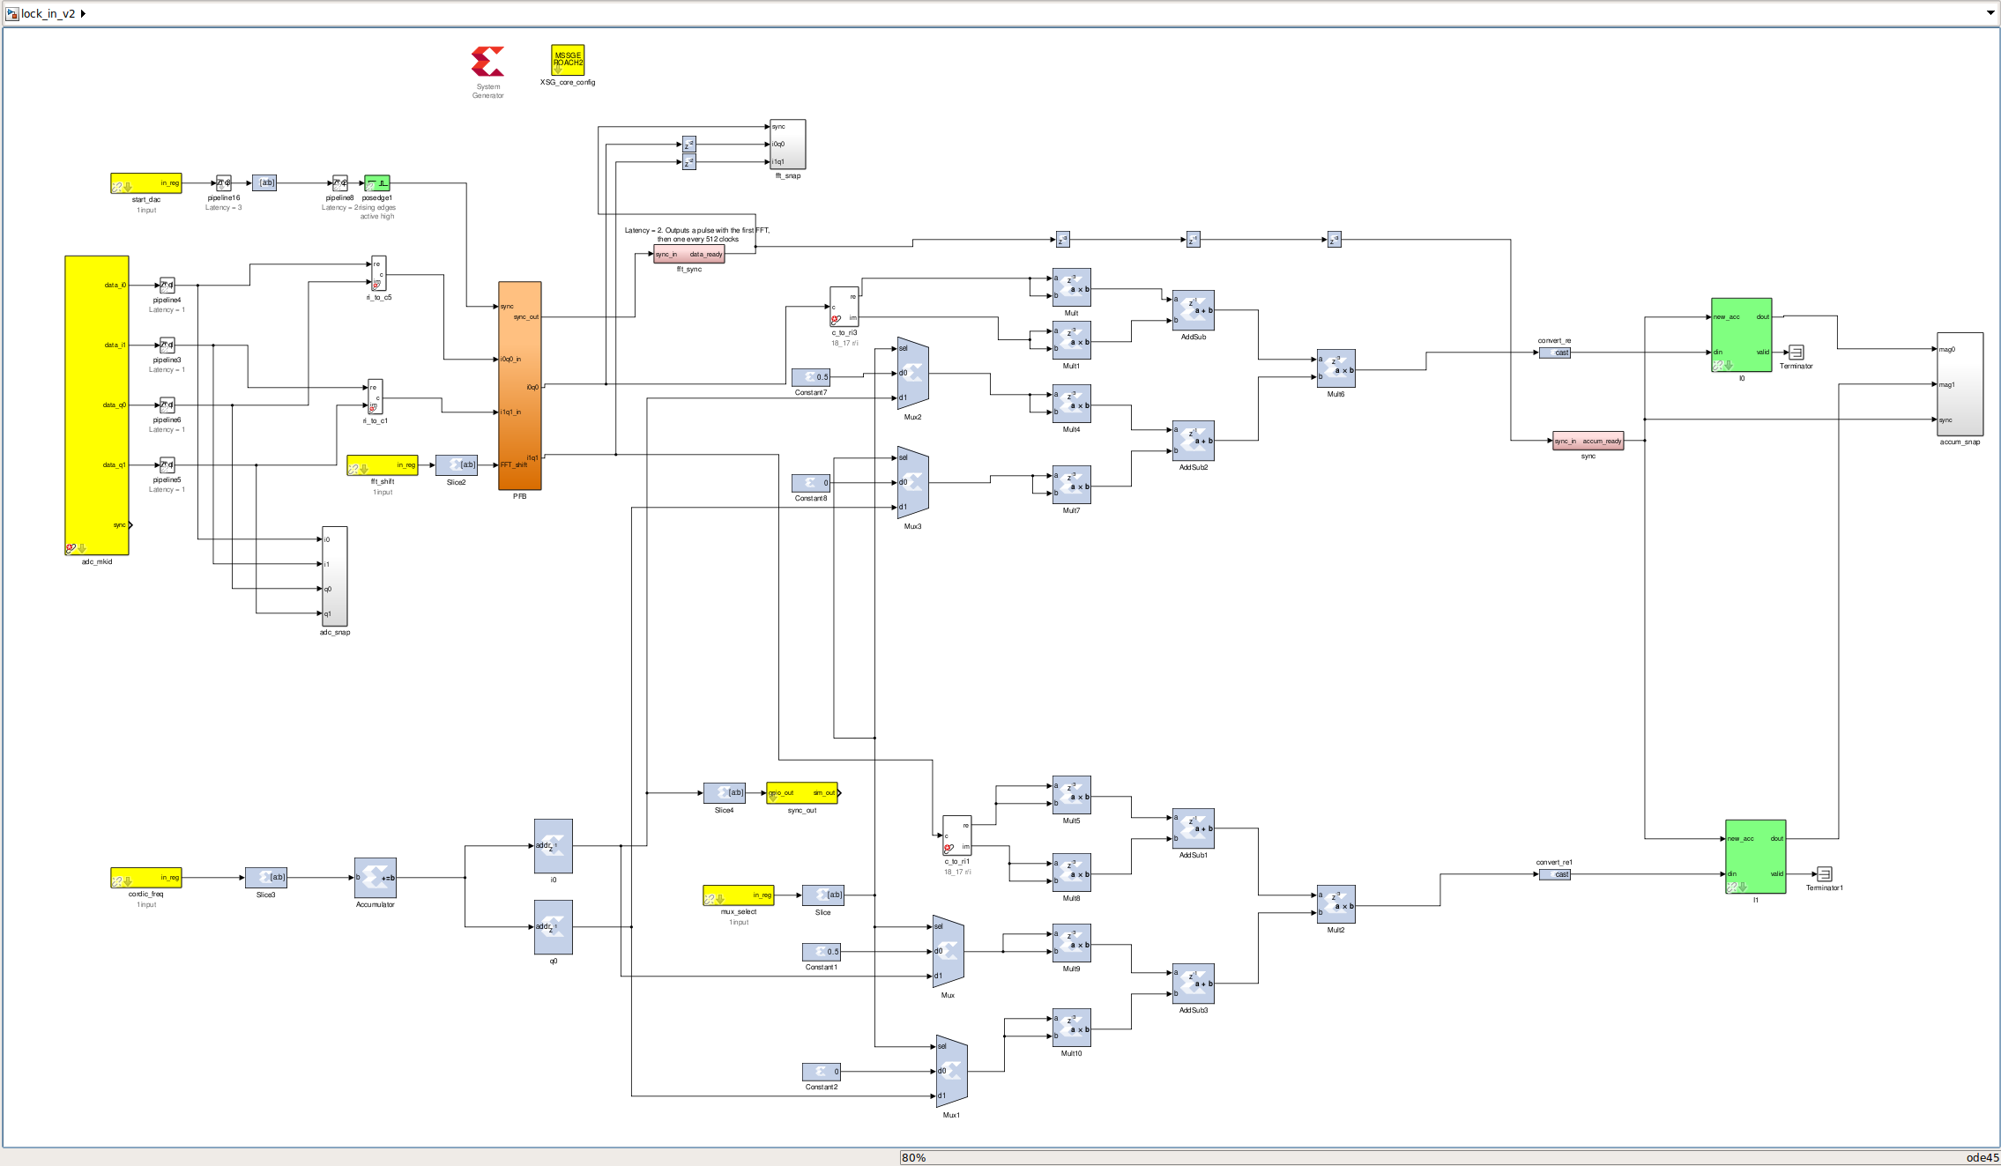
Compileable Firmware V2
Switched order of lock-in mixing and magnitude
Significantly higher bit growth

Slide 28
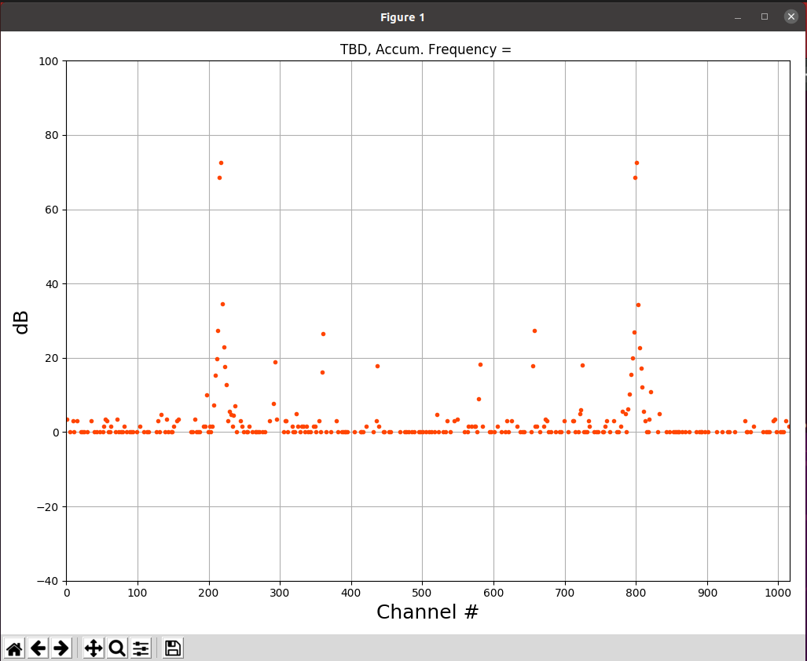
Accumulation Plot for V2
Better SNR compared to V1
Need to take time to compare the two designs
Specify exactly when and how many bits need to be removed to fit in memory block

Slide 29
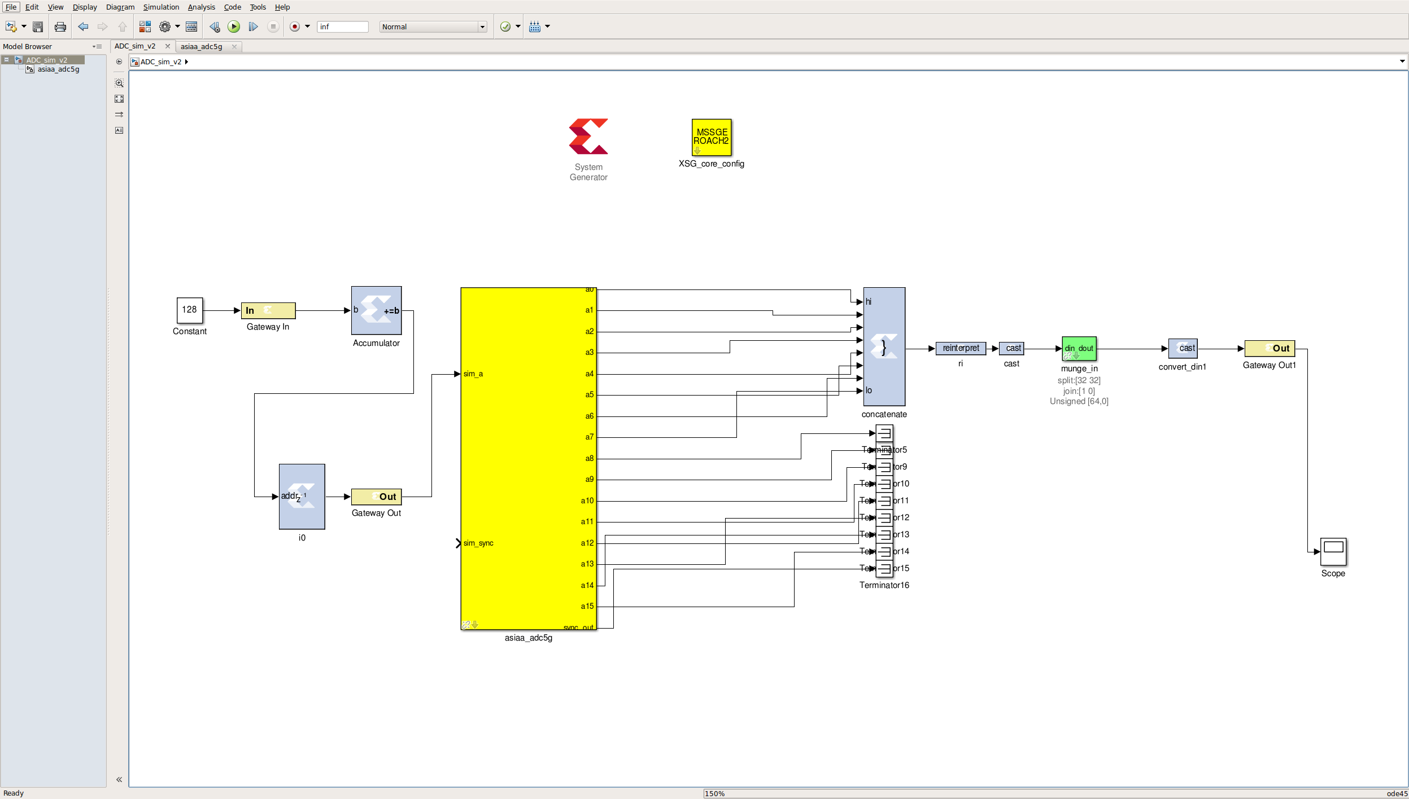
ASIAA 5G ADC

Slide 30
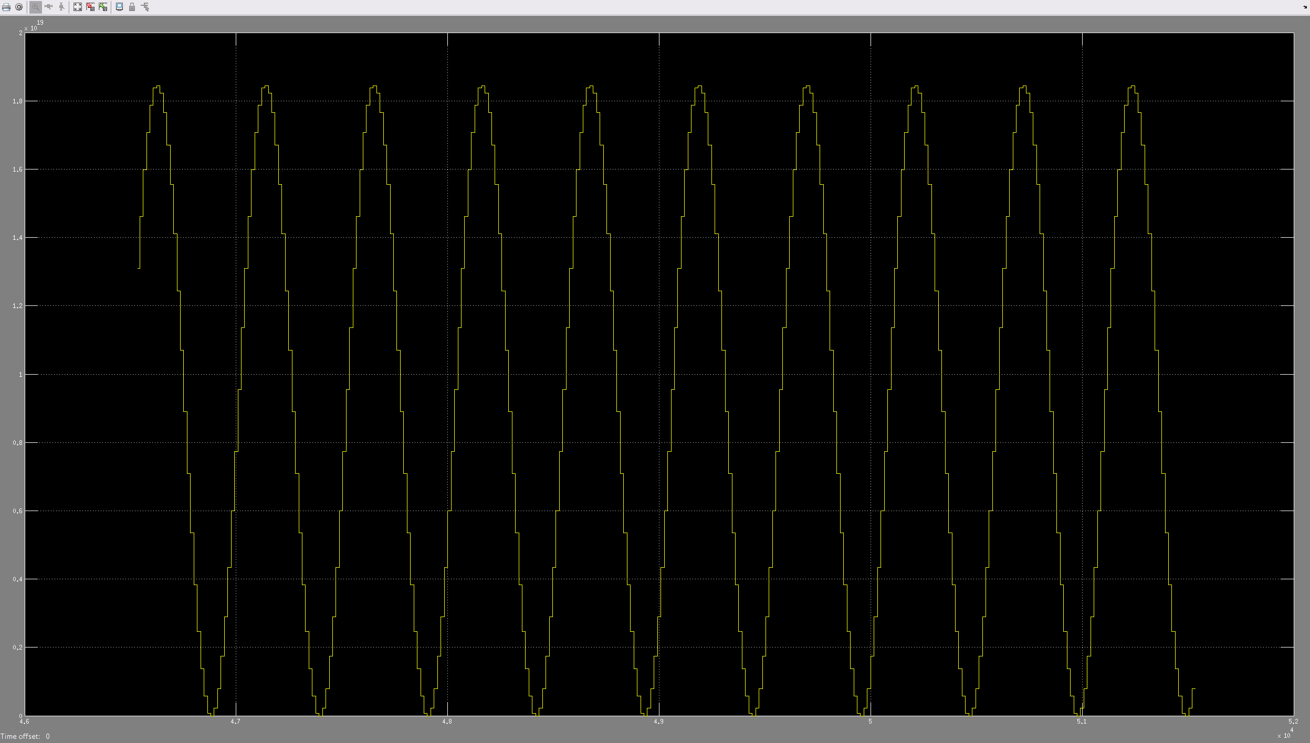
Simulation Results

Slide 31
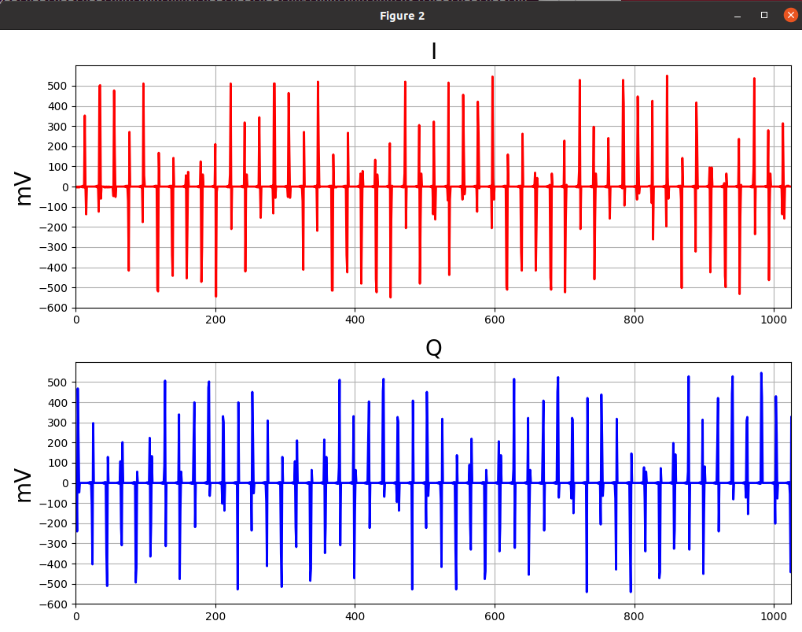
Actual Results from Compiled Firmware

Slide 32
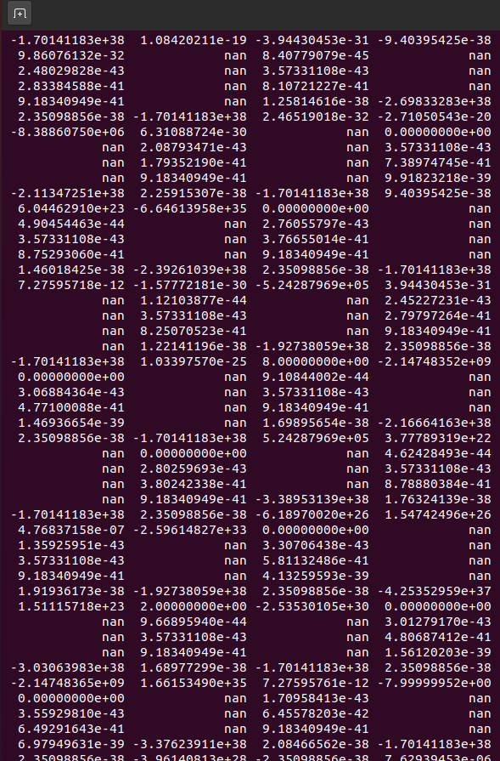
Odd Data Readings

Slide 33
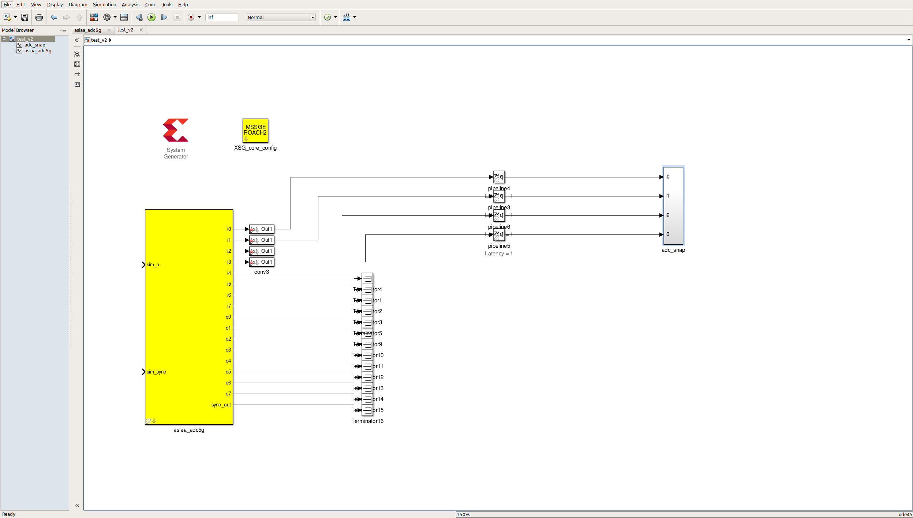
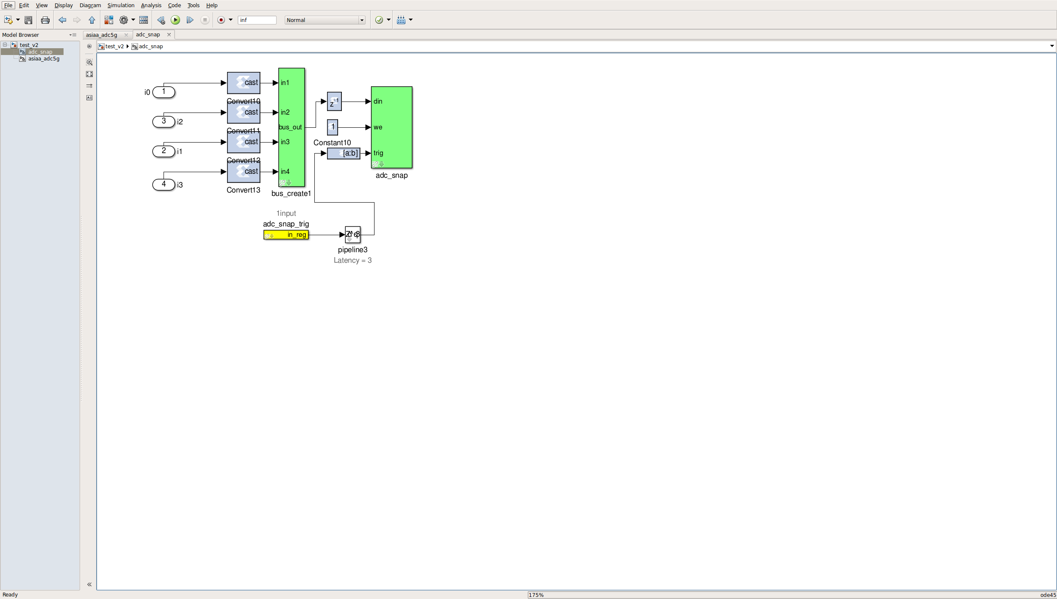
The Debugging Rabbithole

Slide 34
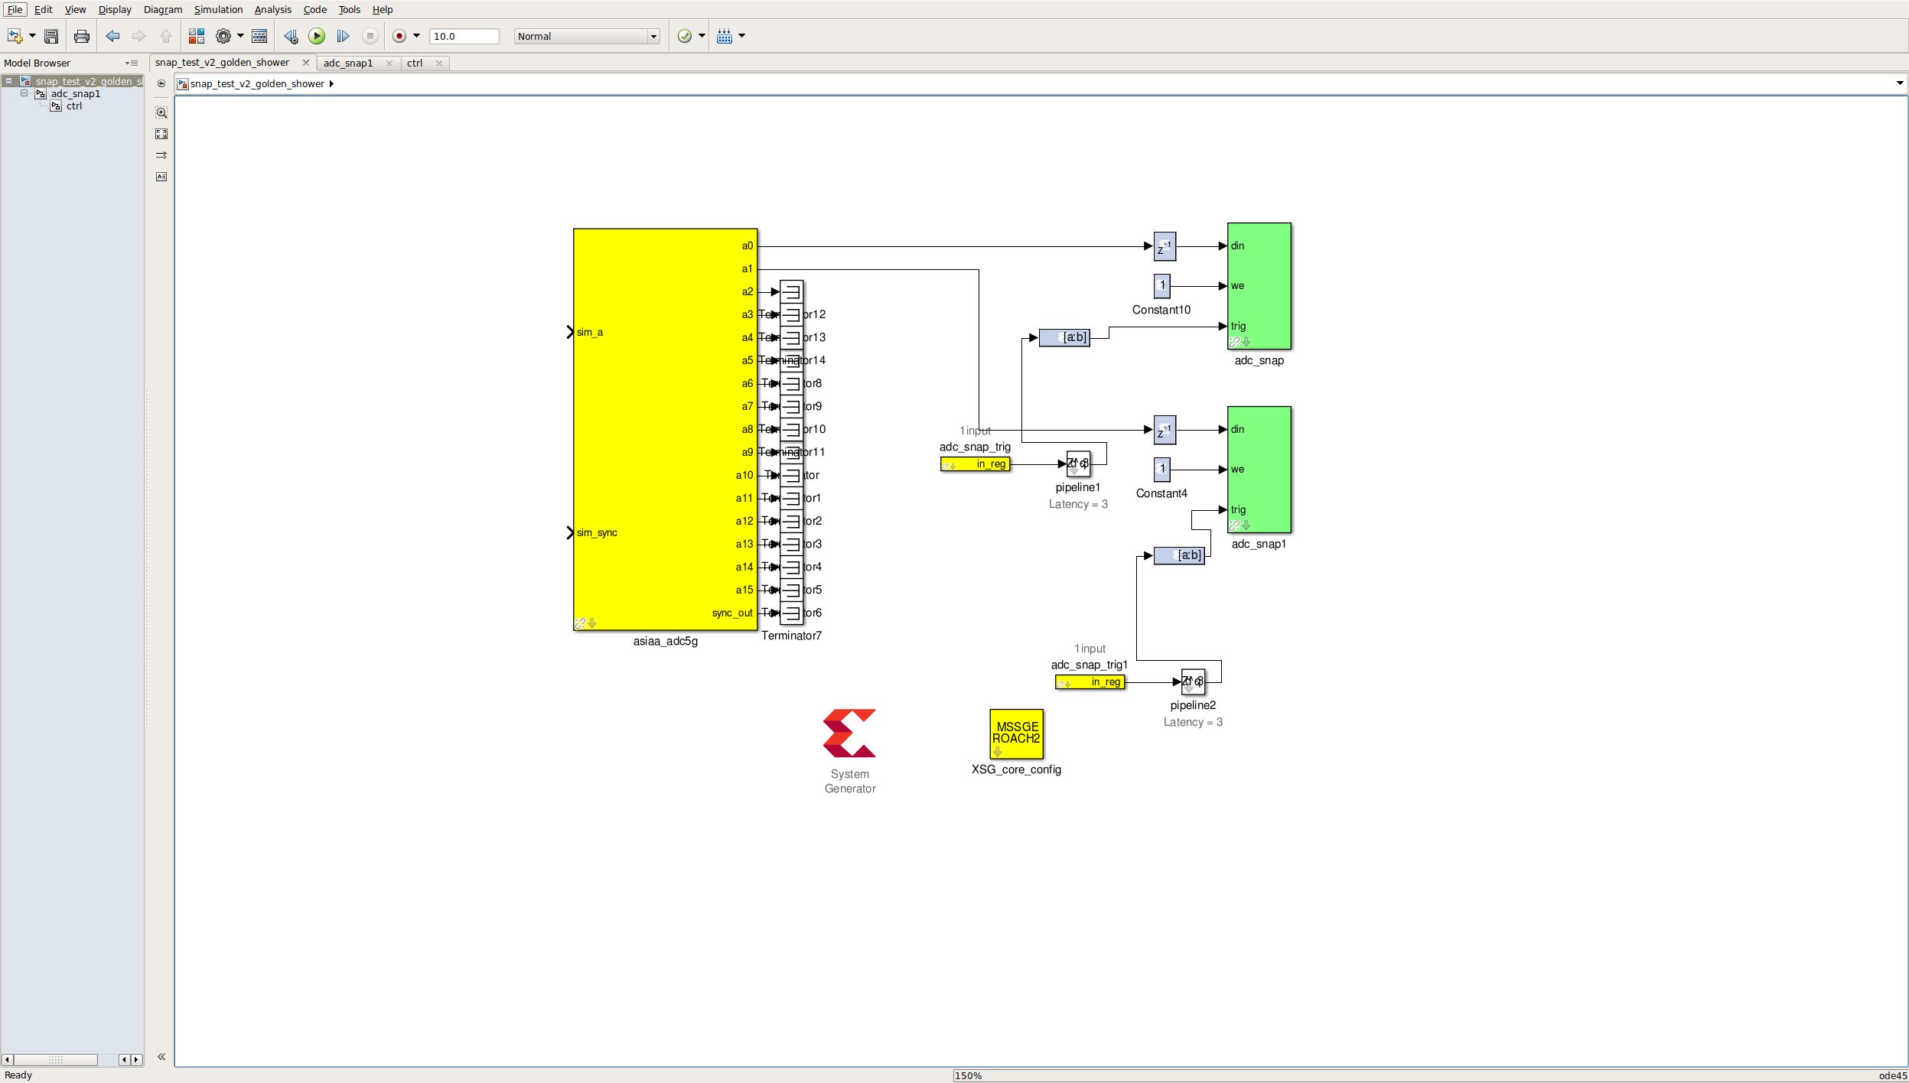
The Debugging Rabbithole

Slide 35
Ugh

Slide 36
Digging out of the Rabbithole
Priorities
Make sure that there is a fully functioning firmware for 512 Msps ADC
Set up waveform generator for FM instead of AM
Once working comfortably, revisit 5 Gsps ADC

